Slide 1
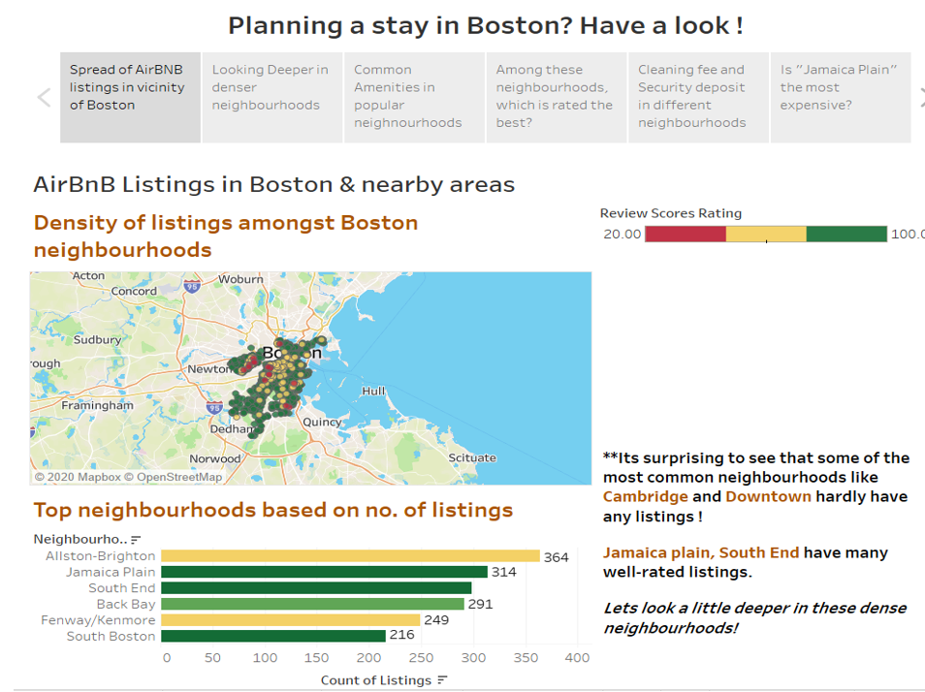
Airbnb Listings Analysis
- By Mansi Nagraj

Slide 2
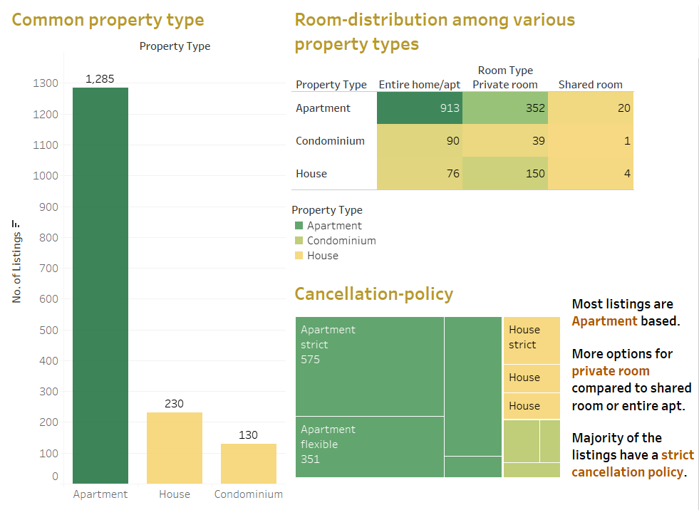

Slide 3
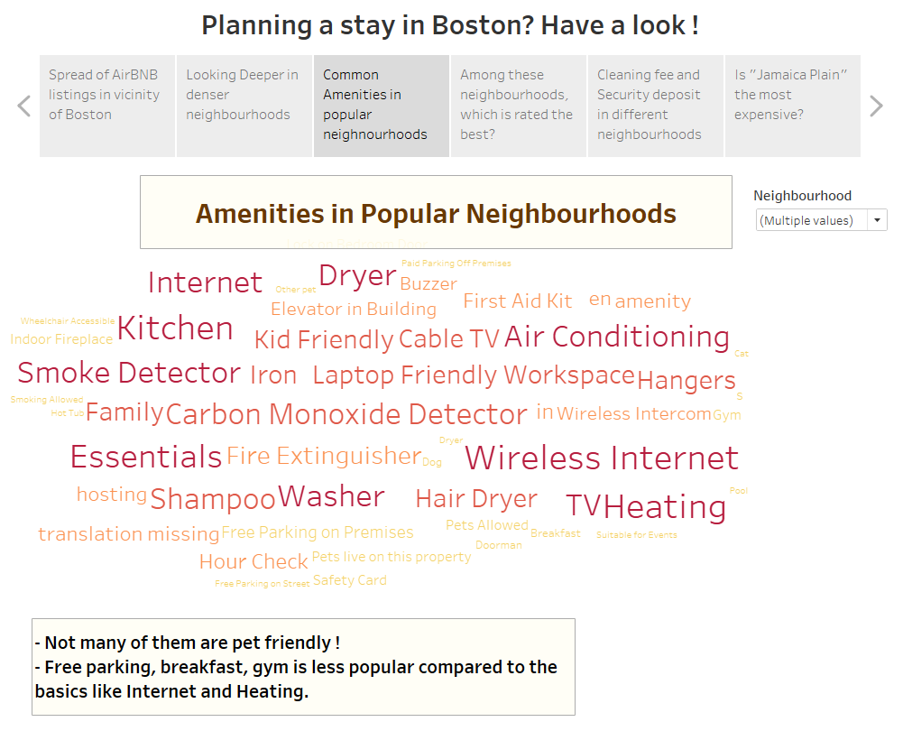

Slide 4
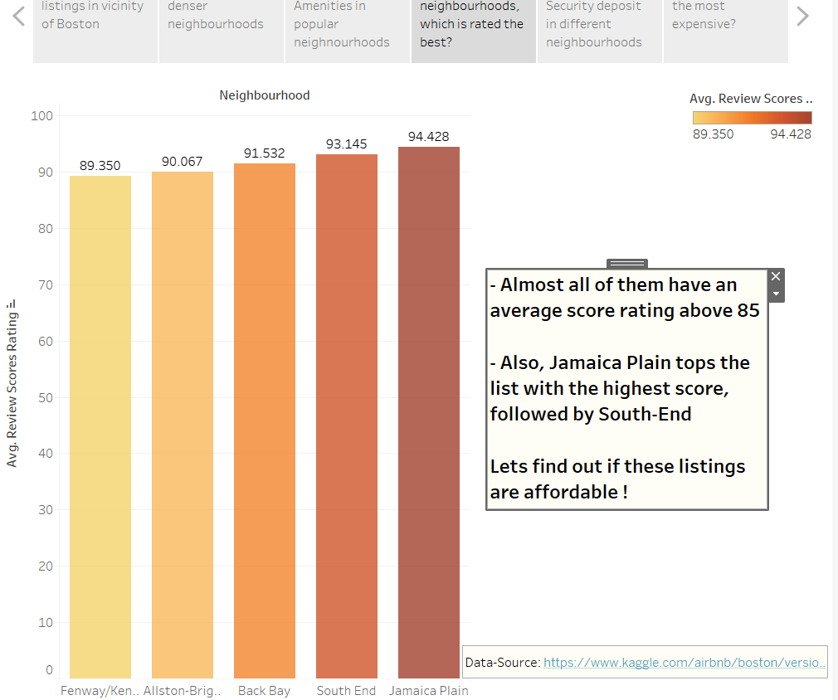

Slide 5
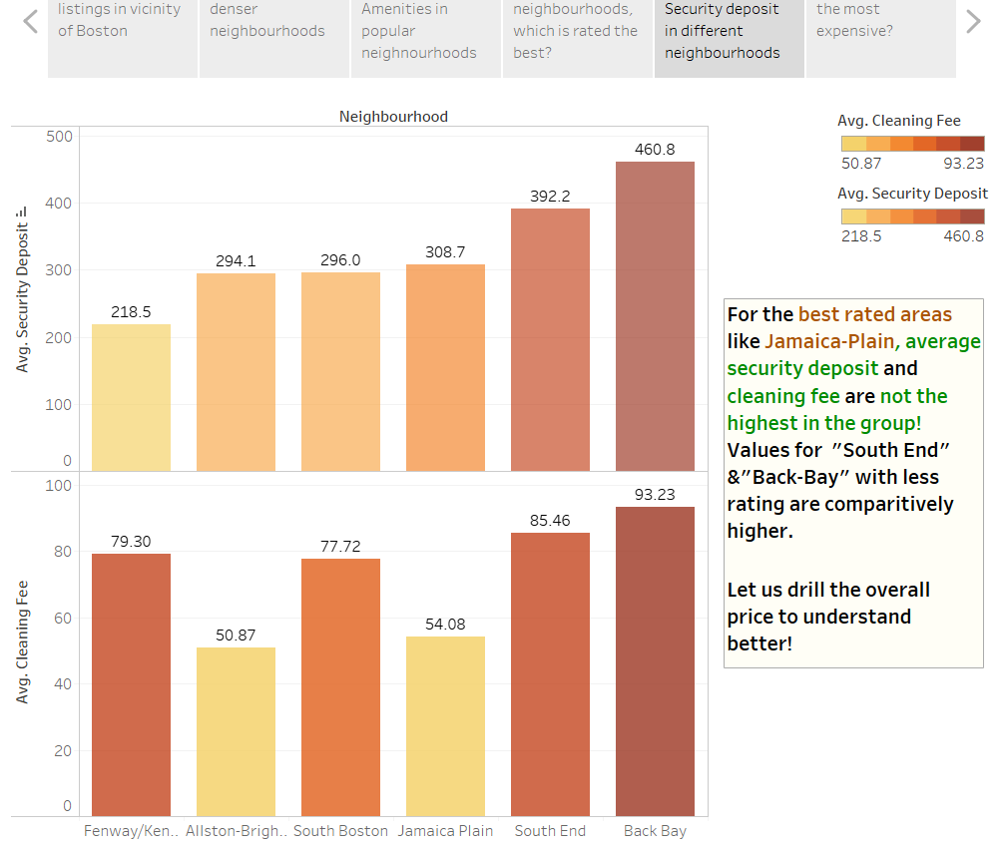

Slide 6
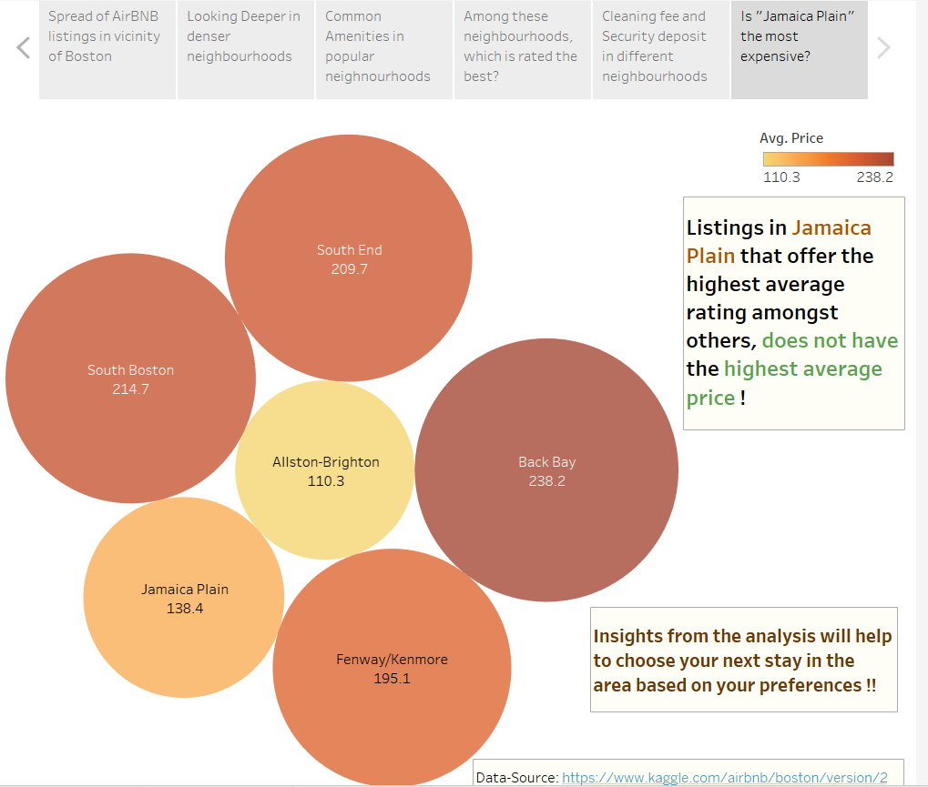
Github Link to the Project:
https://github.com/Mansi-Nagraj/Airbnb-Listings-Analysis

